Slide 1
Best Practices for RAG Applications
Michele Luca Contalbo
micheleluca.contalbo@unimore.it
University of Modena and Reggio Emilia, Italy

Slide 2
Relevant resources
Searching for Best Practices in Retrieval-Augmented Generation, Wang et al., EMNLP 2024
Dense X Retrieval: What Retrieval Granularity Should We Use?, Chen et al., EMNLP 2024
Lost in the Middle: How Language Models Use Long Contexts, Liu et al., TACL 2024
BEIR: A Heterogenous Benchmark for Zero-shot Evaluation of Information Retrieval Models, Thakur et al., NeurIPS 2021
ColBERT: Efficient and Effective Passage Search via Contextualized Late Interaction over BERT, Khattab et al., SIGIR 2020
Document Expansion by Query Prediction, Nogueira et al., ArXiv 2019
Query Rewriting in Retrieval-Augmented Large Language Models, Ma et al., EMNLP 2023
A Survey on Automated Fact-Checking, Guo et al., TACL 2022
Speech and Language Processing, D. Jurafsky, J.H. Martin, third edition
main inspiration for these slides!

Slide 3
Lecture Plan
Retrieve & Rerank pipeline and RAG
Optimizing the performance of RAG
Use case: Fact Checking

Slide 4
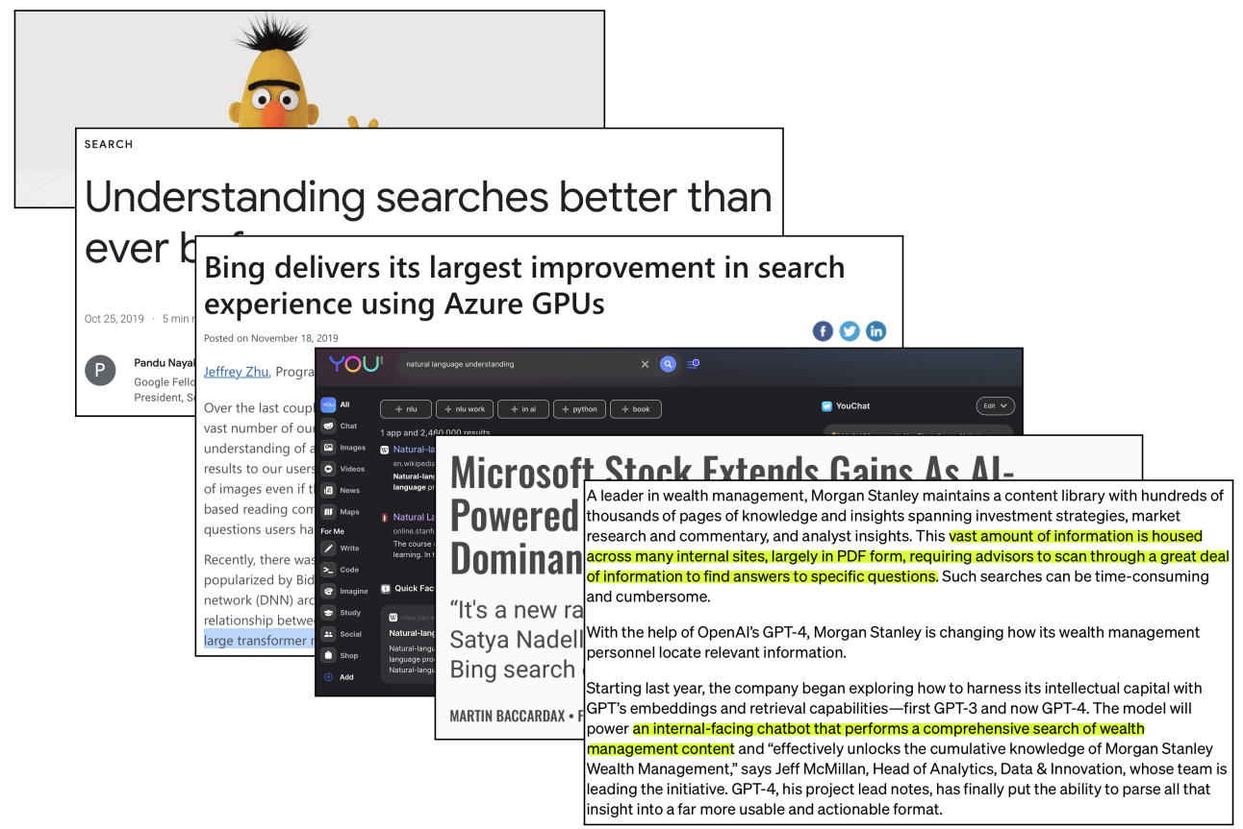
NLP is revolutionizing Information Retrieval (IR)

Slide 5
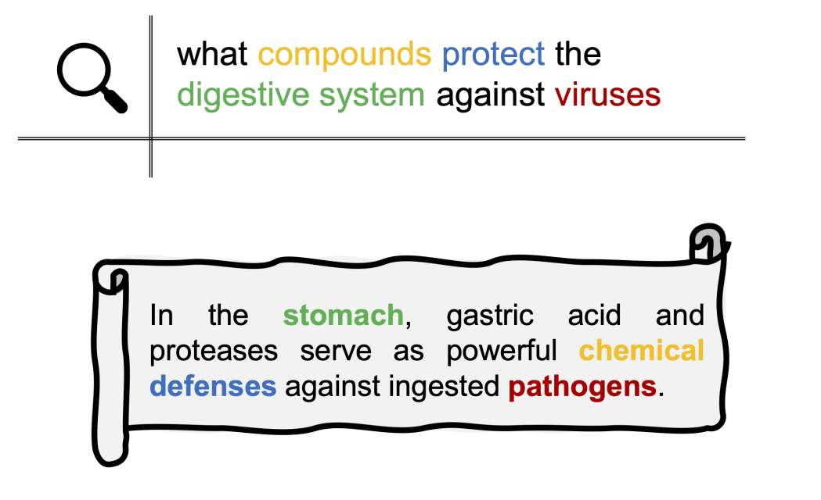
IR is a hard task
In retriever applications, a query q is used to search among a set of candidate documents d_{i…n}, returning the documents that match the best the “information need” requested by the query.
A retriever application must be able to correctly quantify the similarity between the query and the document,
even when the concepts are expressed using different terms, and there’s no lexical overlap.

Slide 6
The retriever can be either sparse or dense
Sparse retrievers:
are also called lexical retrievers, because they are based on exact word matches
  examples are BM25, TF-IDF
👍 they are very fast to compute, as they do not involve any neural models
👍 these algorithms are easy to implement, and can perform well in several occasions
👎 they suffer from out-of-vocabulary issues: words that are not seen during indexing of the documents, but are seen inside the query, are completely discarded
👎 they require exact word-matches: synonyms are treated as completely different words
Dense retrievers:
are approaches based on neural networks
👍 they usually perform better than sparse retrievers
👍 the out-of-vocabulary issue is greatly reduced due to novel tokenization methods (e.g. WordPiece), and they extract the similarity through text semantics and not lexical overlap
👎 they are more computationally expensive

Slide 7
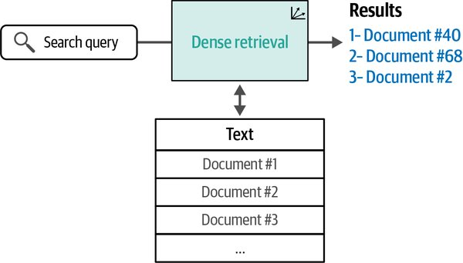
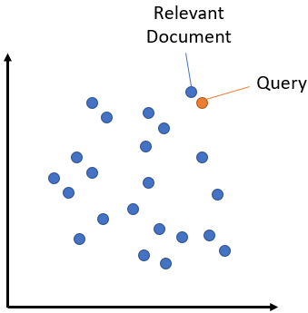
Dense bi-encoder retrievers
Dense retrieval systems turn the search problem into retrieving the nearest neighbors of the search query (after both the query and the documents are converted into embeddings).

Slide 8
Dense bi-encoder retrievers
Procedure (during index creation):
Start off with a set of textual documents d_{i}. As “retrieval units” we can either use the whole document, or chunk the document into sentences
Embed each retrieval unit using a dense bi-encoder retriever using either the [CLS] or average pool of the token embeddings
Save the embeddings and build the search index (for example, using a vector database)
Procedure (during inference):
Given a query q, use the dense bi-encoder retriever to get the query embedding, using the same pooling operation used for the retrieval units
  Both the query and the retrieval units are fed to the model independently between each other
    i.e., the query doesn’t “see” the documents, and viceversa
The similarity between e_{q} and e_{d} is calculated with the cosine similarity
This process is repeated for each retrieval unit in the corpus, obtaining a ranking of the most similar documents

Slide 9
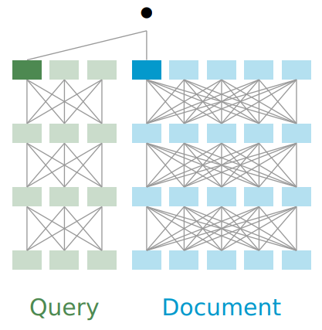
Dense bi-encoder retrievers
👍 Bi-encoders are fast, as document embeddings can be computed and stored, and during inference only the query embedding needs to be calculated (one forward pass)
👎 limited query/doc interactions: the embeddings cannot fully grasp the connection between q and d

Slide 10
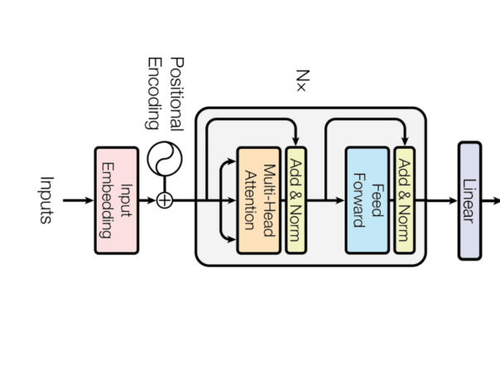
How are dense bi-encoder retrievers trained?
e_{q}
Query:
“How do I bake sourdough bread?”
L(e_{q}, e_{d})
Document about “sourdough bread”
e_{d}
Problem: the loss must reason on two examples

Slide 11
Siamese Network
e_{q}
Query:
“How do I bake sourdough bread?”
Shared parameters
L(e_{q}, e_{d})
Document about “sourdough bread”
e_{d}
Solution: “create” two copies of the network with shared weights (siamese networks)

Slide 12

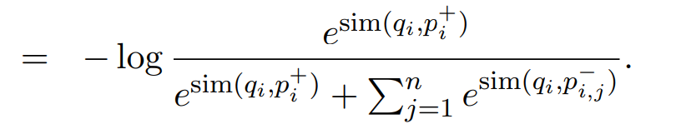
Dense bi-encoder retrievers training loss
Let D = {(q_{i} , p⁺_{i} , p⁻_{i,1},..., p⁻_{i,n}} for i=1…m be the training data that consists of m instances. Each instance contains one question q_{i} and one relevant (positive) passage p⁺_{i} , along with n irrelevant (negative) passages p⁻_{i,j}
We optimize the loss function as the negative log likelihood of the positive passage:
Negative samples can be obtained by randomly extracting non-gold samples from the dataset.
However, a better approach are hard-negatives, i.e. samples that are difficult to classify as negatives.
For example, these samples could be extracted using BM25 -> top passages returned by BM25 which don’t contain the answer but match most question tokens.

Slide 13
Dense bi-encoder retrievers training loss
The idea of applying the loss with hard-negative mining is to push away (in the representation space) documents that are similar, but do not contain the answer
Document about “sourdough bread”
Document about “difference between sourdough bread and bread sticks”
Query:
“How do I bake sourdough bread?”
bring them closer
push them farther
Document about “cooking pasta”
Document about “bread sticks”

Slide 14
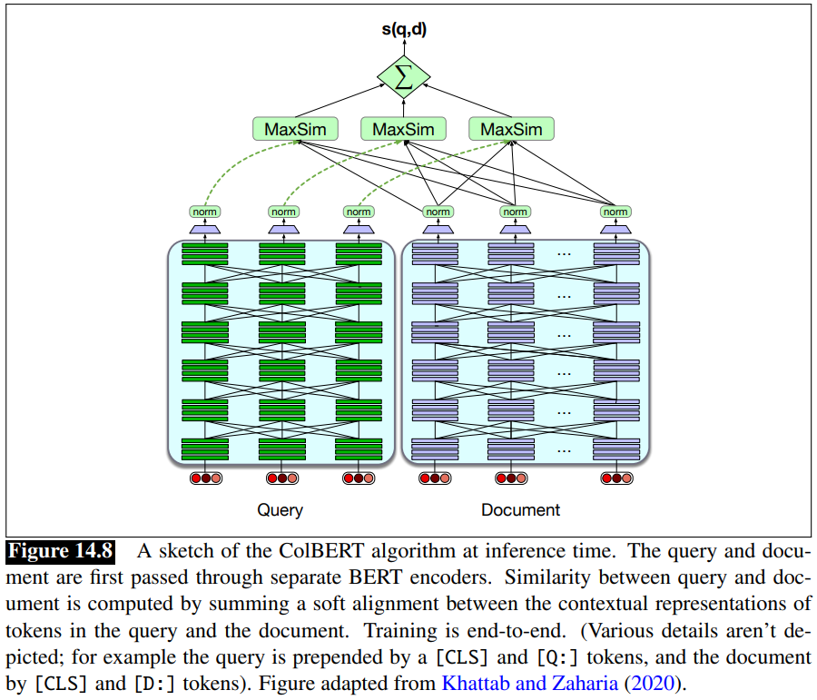
Dense late-interaction retrievers - ColBERT

Slide 15
Dense late-interaction retrievers - ColBERT
Late interaction retrievers do not use sentence embeddings, but compute similarities at the token level
indeed, most of the times we are interested in only a part of the document to retrieve, while the rest is often mainly noise
In particular,
ColBERT computes the maximum similarity between each query token and the document tokens
Then, it sums the similarity scores obtained for each token
The final score is considered as how much similar is the query w.r.t the document
This approach is slower than standard dense bi-encoders, due to the multiple cosine similarity computations to be performed for each query token

Slide 16
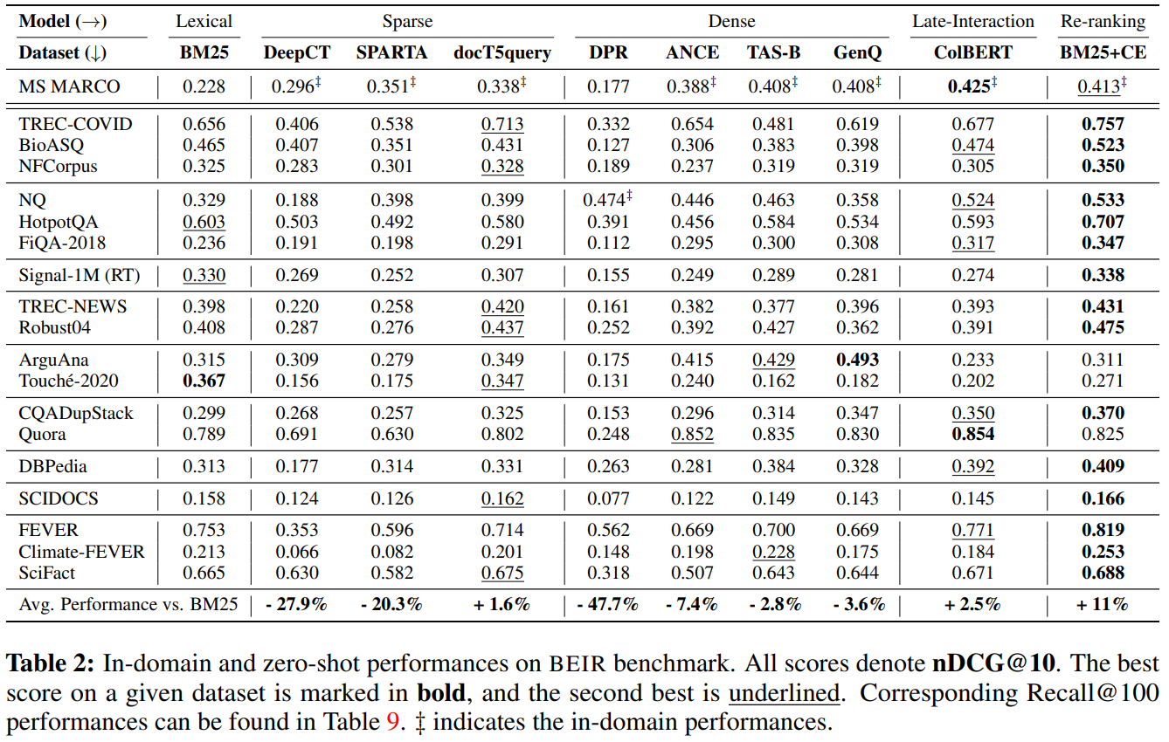
Hybrid retrievers
Relatively “simple” methods like BM25 are actually pretty strong and can compete with the latest BERT based models.
Usually, a good approach for information retrieval is to combine the similarity scores of lexical methods with the scores obtained from encoder methods

Slide 17
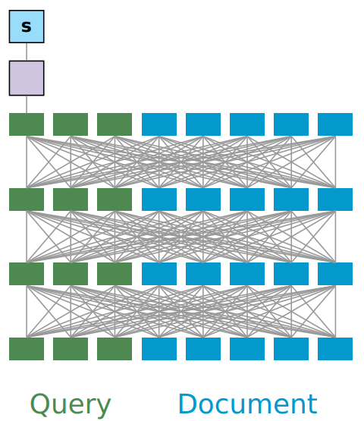
Dense retrievers: cross-encoders
We start off with a query q and a document d
Both the query and the document are fed to an encoder model by concatenating q and d into a unique input
  i.e., “[CLS] <q> [SEP] <d> [SEP]”
We get one scalar value as a result. The highest the value is, the more similar are the query and document
This process is repeated for each document in the corpus
👍 Cross-encoders are more accurate than bi-encoders, as they can better assess the similarity between query and document
👎 they are extremely slow (n forward passes per query, with n being the number of documents)

Slide 18


Dense retrievers: cross-encoders training loss
The training loss can either be:
binary cross-entropy (for pointwise classification)
  considering s(q,d) to be the logit for a query q and document d,
it is not strong, as it doesn’t directly optimize ranking
pairwise logistic (for pairwise ranking classification)
  considering a query q, and two documents d₁ and d₂, with s⁺ = s(q, d₁) and s⁻ = s(q, d₂),
this loss is better, as it depends from the ranking of positive documents compared to negative ones

Slide 19
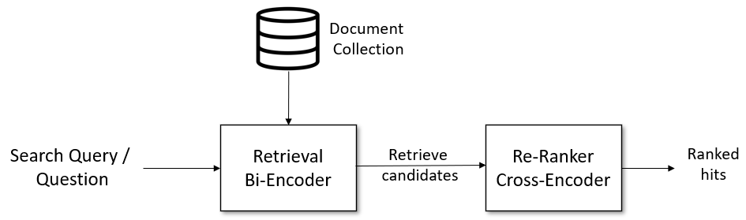
Retrieve & Rerank pipeline
Bi-encoders / Late-Interaction / Hybrid-systems are quick but less accurate, while cross-encoders the opposite.
Is there a way to combine the advantages of the two approaches?
We can use a bi-encoder model to first retrieve the n most similar documents w.r.t. the query (e.g. n = 1000)
Then, we use a cross-encoder model as a re-ranker to improve the sorting of the n candidates
At this point, we take the k most similar documents w.r.t. the query (with k<=n) and use it for further processing

Slide 20
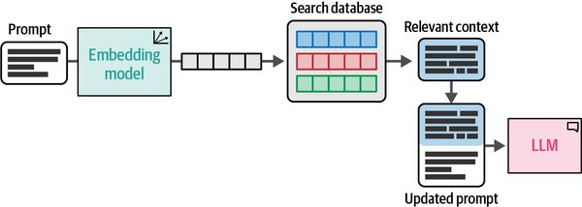
Retrieval Augmented Generation (RAG)
Retrieval models (& Rerank) can extract documents that can be subsequently fed to an LLM as additional context.
LLMs may lack some knowledge and often hallucinate: in specific tasks, like question answering, retrieving relevant information, and then prepending the information inside the LLM context (prompt) largely improves LLM accuracy and drops hallucination rate

Slide 21
Lecture Plan
Retrieve & Rerank pipeline and RAG
Optimizing the performance of RAG
Use case: Fact Checking

Slide 22
Finding the optimal retrieval implementation
Retriever pipelines can be substantially tuned to provide higher quality results via
Choosing the right chunk granularity
Query Classification
Query Transformations
Document Repacking
Document Summarization

Slide 23
Finding the optimal retrieval implementation
Retriever pipelines can be substantially tuned to provide higher quality results via
Choosing the right chunk granularity
Query Classification
Query Transformations
Document Repacking
Document Summarization

Slide 24
Choosing the right chunk granularity
Right now, we have considered one embedding for each document, regardless of the document’s size. This has several drawbacks:
we embed only a small portion of the document due to the model’s context size (e.g. the title and first paragraphs of the document)
  a lot of information would be left out and the index would be difficult to search
we can divide the document in chunks, embed those chunks, and then aggregate (e.g., average) those chunks into a single vector.​
  it results in a highly compressed vector that loses a lot of the information in the document
This approach can satisfy some information needs, but not others.
A lot of the time, a search is for a specific piece of information contained in an article, which is better captured if the concept had its own vector.​

Slide 25
Choosing the right chunk granularity - Chunking strategies
Character-level chunking
Sentence-level chunking
Paragraph-level chunking
Artificial intelligence is transforming many fields. It enables machines to learn from data and make decisions.
In recent years, large language models have become particularly popular. They are used in chatbots, search engines, and writing assistants.
Artificial intelligence is transforming many fields. It enables machines to learn from data and make decisions.
In recent years, large language models have become particularly popular. They are used in chatbots, search engines, and writing assistants.
Artificial intelligence is transforming many fields. It enables machines to learn from data and make decisions.
In recent years, large language models have become particularly popular. They are used in chatbots, search engines, and writing assistants.

Slide 26
Choosing the right chunk granularity - Chunking strategies
Character-level chunking
Sentence-level chunking
Paragraph-level chunking
Artificial intelligence is transforming many fields. It enables machines to learn from data and make decisions.
In recent years, large language models have become particularly popular. They are used in chatbots, search engines, and writing assistants.
Artificial intelligence is transforming many fields. It enables machines to learn from data and make decisions.
In recent years, large language models have become particularly popular. They are used in chatbots, search engines, and writing assistants.
Artificial intelligence is transforming many fields. It enables machines to learn from data and make decisions.
In recent years, large language models have become particularly popular. They are used in chatbots, search engines, and writing assistants.
Breaks textual and lexical coherence.
Does not handle coreferences
Does not handle coreferences
Coreferences are better handled, but each chunk may contain more noisy context

Slide 27
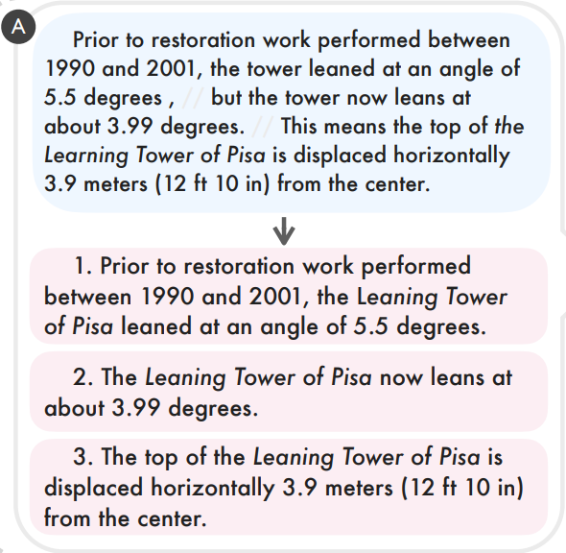
Choosing the right chunk granularity - Propositions
In previous approaches, it is very easy to break coreference links, making the resulting chunks less clear.
At the same time, using larger chunks may introduce noise inside the resulting embeddings.
Solution: transform the text into a set of propositions, i.e. sentences composed by one independent clause containing exclusively (subject, predicate, object) + prepositional phrases:
by either asking an LLM to extract the propositions (may hallucinate)
or by performing coreference resolution first (with a neural dependency parser), followed by splitting the compound sentences (with the same dependency parser)

Slide 28
Choosing the right chunk granularity - Propositions
Indexing and retrieving small chunks may provide to subsequent steps too few information
small chunks are generally good for retrieval
however in some cases, e.g. in RAG applications, we may still need to provide to the final LLM call the whole document (or, in general, big paragraphs), and not just a sentence/proposition
In this case:
We save the whole document’s text inside our database (or, if we need large paragraphs, we split the document in paragraphs, and save each paragraph in the database)
We then chunk the document (or each paragraph) using a chunking strategy (e.g. sentence or proposition chunking), but we also save the link between small chunk -> document (paragraph)
During inference:
retrieval & reranking is performed using small chunks
from the retrieved small chunks, we can obtain back the document (paragraph) we need, so that we can use more textual context for subsequent tasks

Slide 29
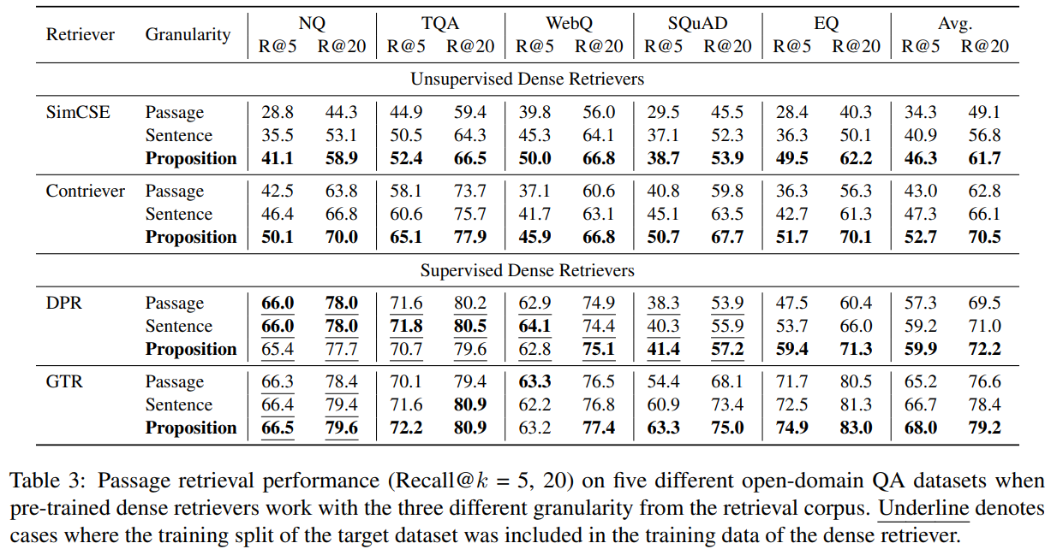
Choosing the right chunk granularity - Propositions

Slide 30
Choosing the right chunk granularity - Propositions
In general:
small chunks
  retrieval performance improves as the embedding is less noisy
  increased memory usage -> we store more embeddings
  may break coreference links and decrease performance if not handled correctly
  propositions are the shortest “coherent” sentences, and greatly improve performance
larger chunks
  opposite of small chunks

Slide 31
Choosing the right chunk granularity - doc2query
One technique to improve the retrieval effectiveness of a search engine is to expand the chunks (or create new chunks) with terms that are related or representative of the chunks’ content
from the perspective of a question answering system, this might comprise questions the document can potentially answer
consider that a RAG system is often queried with questions
  then, by indexing in our RAG system the questions that each chunk can answer, there should potentially be a larger lexical / grammatical / semantic overlap between the query and the chunks (in question form)
Solution: use a sequence-to-sequence model or LLM to generate the questions from each textual chunk, and either (i) concatenate the question to the textual chunk before indexing in the database, or (ii) directly treat the generated questions as novel retrieval units (chunks)

Slide 32
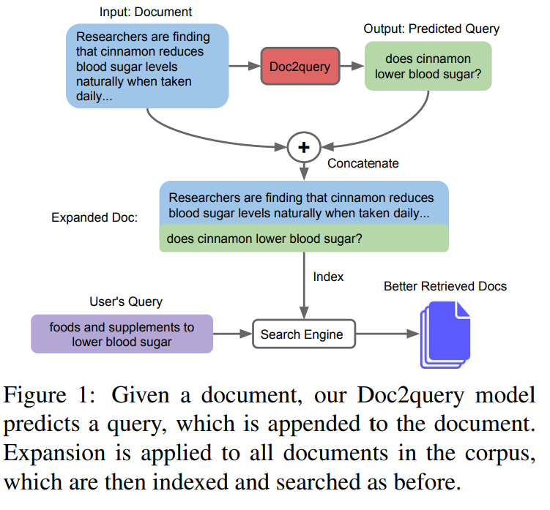
Choosing the right chunk granularity - doc2query

Slide 33
Finding the optimal retrieval implementation
Retriever pipelines can be substantially tuned to provide higher quality results via
Choosing the right chunk granularity
Query Classification
Query Transformations
Document Repacking
Document Summarization

Slide 34
Query Classification
Not all queries require to be retrieval-augmented due to the inherent capabilities of LLMs
while RAG can enhance information accuracy and reduce hallucinations, frequent retrieval costs longer response time
some interactions with RAG systems are simple follow-ups of previous interactions in which documents were retrieved -> no need to search again
some queries are already well-known by the LLM’s internal weights, and using external retrieved context may just confuse the model
Solution: use the LLM to classify whether the available knowledge is already “sufficient”, which need not retrieval, or “insufficient”, where retrieval is necessary

Slide 35
Finding the optimal retrieval implementation
Retriever pipelines can be substantially tuned to provide higher quality results via
Choosing the right chunk granularity
Query Classification
Query Transformations
Document Repacking
Document Summarization

Slide 36
Query Transformations - Query Rewriting
Retrievers perform better when the queries explicitly indicate, in a short manner, what are the information needs
queries may be composed of multiple “hops”, where multiple operations must be performed to obtain the answer
lengthy / multi-hop queries may be too noisy to be correctly understood by retrievers
Solution: train a “query rewriter” (or use an existing LLM) to (i) decompose the question into multiple subquestions; (ii) turn each subquestion into information needs (iii) run each rewritten query, retrieve the documents and aggregate them
for example, instead of the query “What profession does Nicholas Ray and Elia Kazan have in common?”, better information needs could be “Nicholas Ray profession” and “Elia Kazan profession”

Slide 37
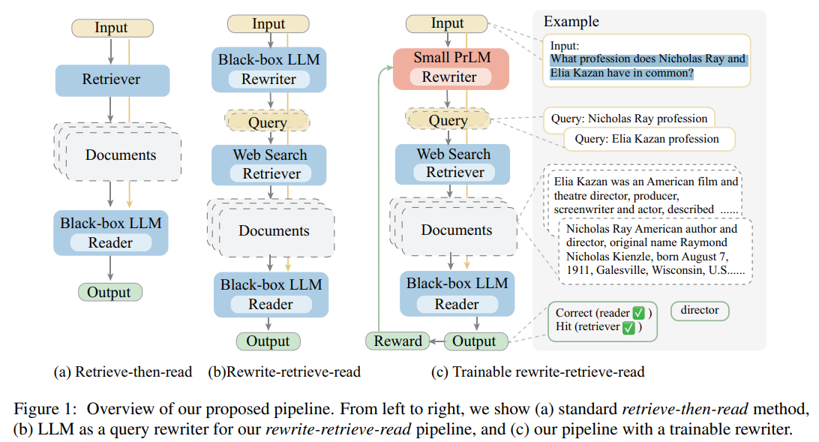
Query Transformations - Query Rewriting

Slide 38
Finding the optimal retrieval implementation
Retriever pipelines can be substantially tuned to provide higher quality results via
Choosing the right chunk granularity
Query Classification
Query Transformations
Document Repacking
Document Summarization

Slide 39
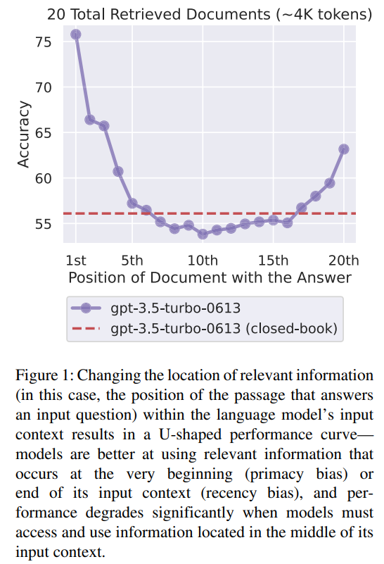
Document Repacking
The performance of subsequent processes, such as LLM response generation, may be affected by the order documents are provided
LLM performance varies depending on the position of the correct data inside its context, usually following a V shape pattern
There are three strategies based on how you position the documents:
the “forward” strategy, i.e. documents positioned in descending importance order
the “reverse” strategy, i.e. the opposite
the “sides” strategy, i.e. one at the beginning, then end, then second position, then second last etc.
Note: the “forward” approach may work worse than expected due to the presence of the prompt instruction, which already usually covers the beginning of the prompt

Slide 40
Finding the optimal retrieval implementation
Retriever pipelines can be substantially tuned to provide higher quality results via
Choosing the right chunk granularity
Query Classification
Query Transformations
Document Repacking
Document Summarization: not too much to say… when the retrieved content is huge, summarize it

Slide 41
Lecture Plan
Retrieve & Rerank pipeline and RAG
Optimizing the performance of RAG
Use case: Fact Checking (Google Colab)

Slide 42
Thank you for the attention!
micheleluca.contalbo@unimore.it
Notes:
That's all for this presentation.
Thank you for your attention.
If you are interested in further investigating the work or reproducing the experiments in this paper, we suggest to consult the GitHub repository where we have open-sourced all the supplementary material.
Thank you

